Slide 1


National Data Centre & Cloud Empowerment
Development Council
-a Real Opportunity for Development
Keynote Presentation
By
Prof. NK Goyal, President CMAI
Chairman Emeritus, TEMA. Vice Chairman ITU APT
Chairman, ITPS Dubai
Member, Governing Board Telecom Equipment and Services
Export Promotion Council (Govt. of India)
At
Data Cloud India, 13th February 2019
New Delhi
www.cmai.asia

Slide 2
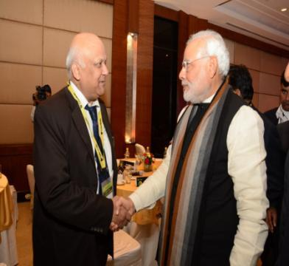
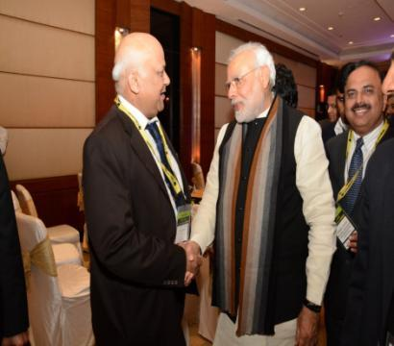
CMAI TEMA
Greetings from Hon’ble Prime Minister of India,
Dr Narendra Modi and 1.2 Billion people of India

Slide 3
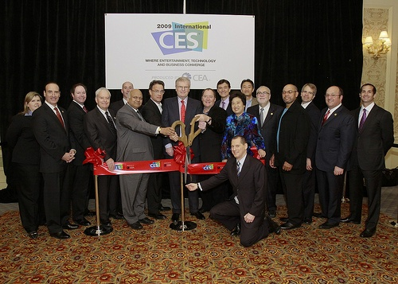

CES, 2009 being inaugurated and ribbon cutting at Las Vegas on 8th January, 2009 by NK Goyal with Sir Howard Stringer, Chairman & CEO of Sony Corporation, Mr. Tom Hanks, the American movie star, Mr.Gary Yacoubian, Chairman CEA & President of Myer-Emco AudioVideo, Mr. Gary Saprio, Vice President of CEA, Ms. Qu., Presixdent, CECC China, Mr. Patrick Lavelle, President and CEO of Audiovox, Mr. Peter Lesser, President and CEO of X-10 (USA) Inc, Mr. Loyd Ivey, Chairman and CEO of MiTek Electronics and Communications, Mr. Jay McLellan, President and CEO of Home Automation, Inc. (HAI), Mr. Mike Mohr, President of Celluphone, Mr.Grant Russell, President of Kleen Concepts

Slide 4
CMAI Goals
Promote Trade Relations with
Government, Industry, Society, Consumer
in
Education, Vocational/Skill Development, Academia Industry Interface, Univ. Exchange Programs, Research Centers
Telecom, ICT, Infrastructure, Renewable Energy, Green Manufacturing,
CYBER SECURITY & ENTREPRENEURSHIP

Slide 5
About CMAI
CMAI is an ICT largest, apex business and trade promotion organization, with 48,500 members and 54 MOU partners across the world with branch offices in China, Japan, Korea, Singapore, Taiwan, Bangkok, USA, UK and Malaysia.
CMAI is involved in policy formulations with Government and other stake holders for Technology Innovations, Indigenous Manufacturing
CMAI is developing scientific knowledge and practical means for protecting human ecology and environment from the harmful effects of environmental hazards like e waste, radiation etc.
CMAI assists manufacturers to maximize competitiveness in the domestic and international markets.

Slide 6
About NK Goyal, President CMAI
Chairman Emeritus TEMA
Chairman CTIA India
Vice Chairman ITU APT India, Affiliate ITU Geneva
Chairman ITPS, Dubai
Member Governing Council TEPC, Govt. of India
Director National Fertilizers Ltd, Govt. of India, PSU
Ambassador India & South Asia, Commonwealth Telecom Organization, CTO, UK
Director World Institute of Spirituality, Nagaland

Slide 7




Slide 8
Data Center
Decades ago Indian economy was dependent upon textile, manufacturing & agriculture but now IT has become major contributor to India’s GDP growth rate.
Data Centers are evolving due to the shift towards virtualization
Rate of increase in Internet users in India has also increased the rate of developments of Data Centers in India.
Data Center is the Critical support Infrastructure which is forecasted to grow at a rapid pace in coming years.

Slide 9
Reasons for Growth of Data Centers
BFSI – Banking Financial Services & Insurance
Telecom
IT
Social Media
E Governance Infrastructure such as NIC, SWAN etc

Slide 10
Big Data for Big Impact
Data technologies are transforming the landscape of several industries such as healthcare, insurance, financial markets, etc. The saying that “information is power” is coming true. Continuous evolution of communication is resulting in rapid information dispersal globally, leading to the coming of age of information societies.
The Indian market is still in early stages of adoption of analytics and there is a need to industrialize it to derive long-term value. Going forward, industry stakeholders need to raise awareness, create talent, standardize tools and set up cross functional Analytics teams to drive industrialization of Analytics in India

Slide 11
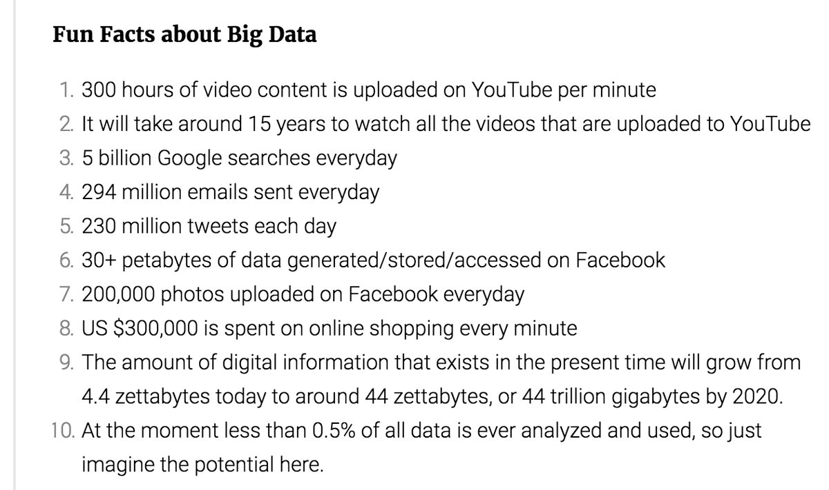

Slide 12
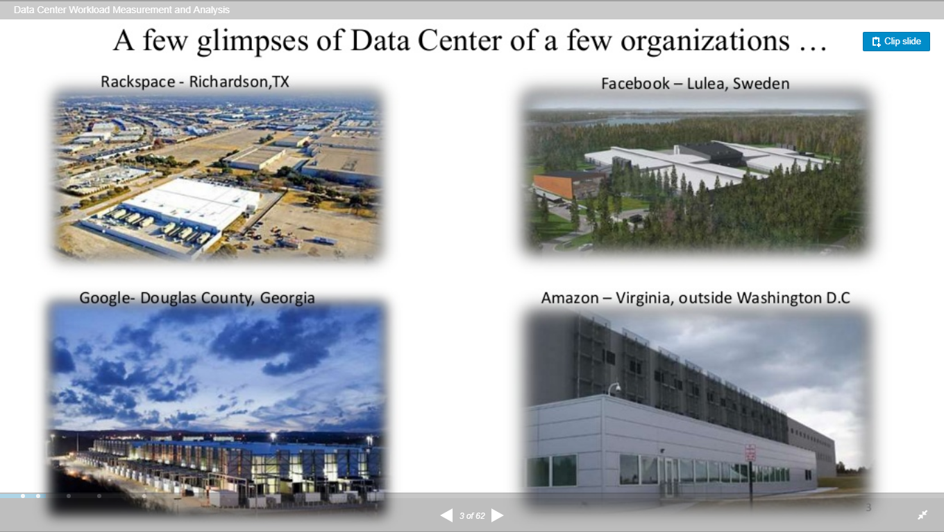

Slide 13
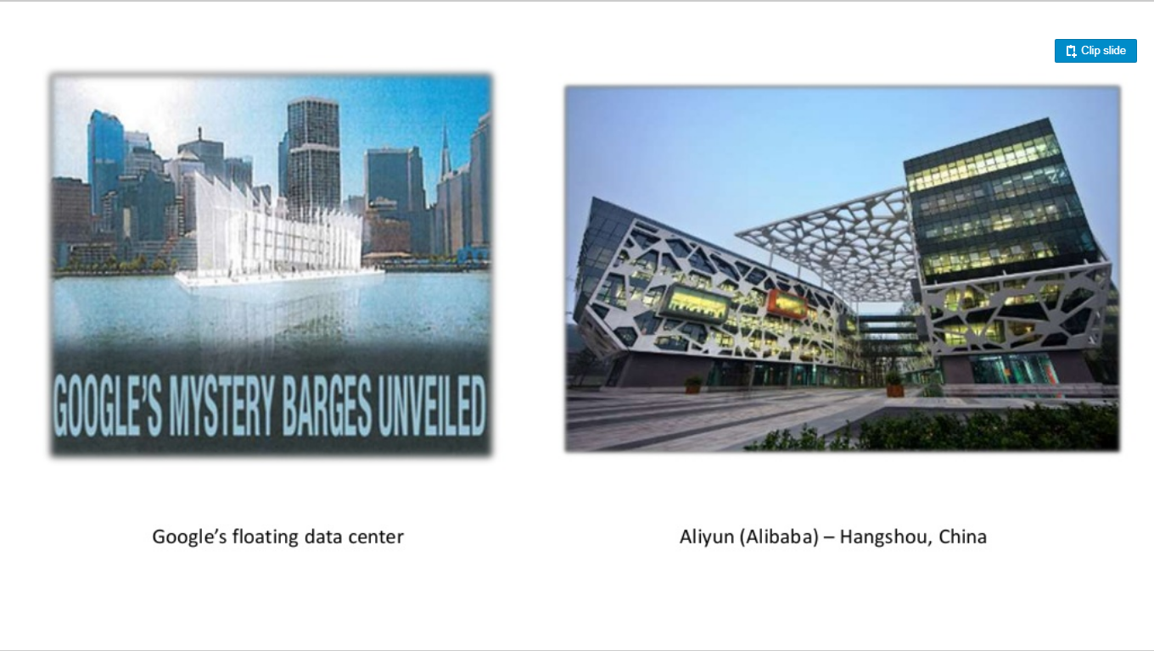

Slide 14
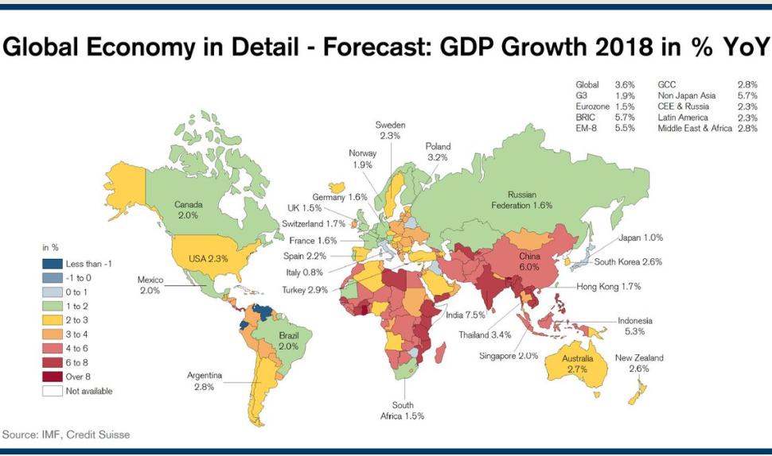
Global Economy

Slide 15
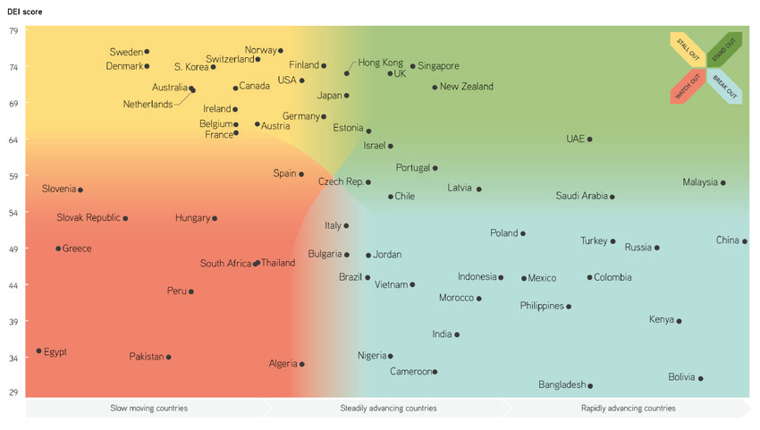
Digital Evolution Index

Slide 16
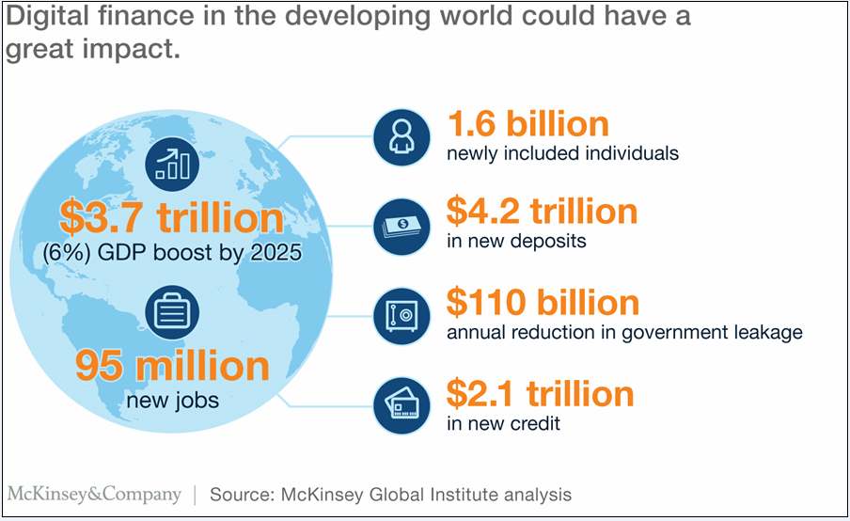
Digital Economy-Digital Finance

Slide 17
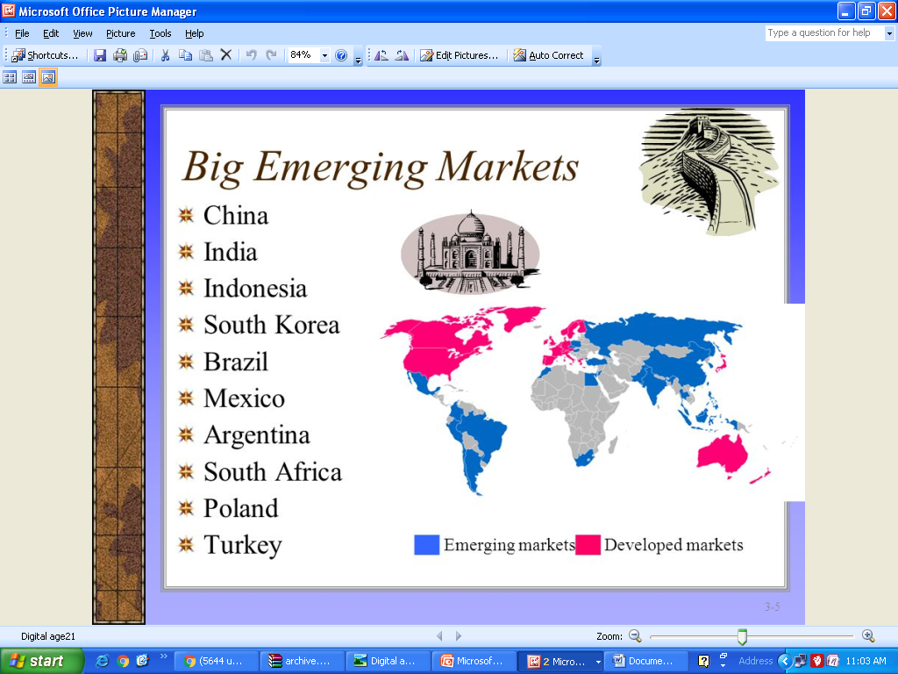
Big Emerging Markets

Slide 18
Global Digital Economy
Digital economy, or Web economy- an economy based on digital computing technologies, comprises of e-business infrastructure and processes, e-commerce, digital payments, Convergence of social media
Provides digital networking, communication infrastructures, a global platform over which people and organizations devise strategies, interact, communicate, collaborate and search for information.
Data creation and storage-growing four times faster than the rate of the global economy.
World- a global village- available at click
Over 3 Bn. mobile phones, half of the global population. Two-thirds of them in developing world.

Slide 19
Digital Economy- changing world
Digital Economy- revolutionizing the way we do business and creating new opportunities for global development, growth prosperity.
Radically changing business landscape- New and emerging digital trends, cloud computing, big data, AI/VR/AR, mobile web services, smart grids and social media
Supporting innovations, new technologies, new business models, convergence of every thing we can dream of.
Networking at unbelievable speeds -100 Gbps and more
M2M, IOT- 500 Bn. devices to get connected by 2030
90% jobs would need digital skills
403 Tr. Gigabyte data creation by IOT by 2018

Slide 20
Digital Technologies
M2M, IOT, hyper connectivity, big data, social media (for viral spreading of communication), MVNO, T2 Lite, advanced analytics, wireless networks, mobile devices etc.
The digital economy uses these technologies to replace the traditional exchanges of communication and enable new ones.
Power in the hands of people- seating in garage in a corner of world—can create business/cripples entire globe.
2.2 Tr. USD additional GDP growth in US due to digitalization by 2025
Digital Economy- worth 3 Tr. USD today-generated in the past 20 years, since the launch of the Internet.
- Accenture and Oxford Economics
New business models: UBER, OLA, OYO, Airbnb, Netflix, Zomato etc
Total worth of IOT 6.2 Tr.USD by 2025(Health 2.5 Tr Mfg 2.3 Tr)

Slide 21
Opportunities Galore
IOT market to grow from USD 561 Bn. in 2022 from 171 Bn. in 2017-CAGR of 27 %. Others targets by 2020 are:
  Government Cloud Market- USD 29 Bn.
  Cellular M2M market- USD 12 Bn.
  Cellular IoT market- USD 5.31 Bn.
  Global Wi-Fi market- USD 34 Bn.
  Near Field Communication- USD 21.84 Bn.
  In-Building Wireless Market- USD 17 Bn.
  5G terminal market- USD 40 Bn.
  Global IOT telecom services market- USD 23 Bn.

Slide 22
Singapore Model
Singapore working on three key growth strategies
  Invest in building frontier capabilities- launched Singapore Data Science Consortium and AI.SG, new national programme to boost Singapore’s AI capabilities.
  Support promising enterprises- several programs launched
  Develop a pipeline of frontier tech talents-launched IMDA’s TechS kills Accelerator
Digital innovation to be used as a force multiplier to meet national priorities and enhance productivity in services sector.
Under the Smart Nation banner, three focus areas critical to national needs- Urban Mobility, Healthcare ICT, Services Productivity

Slide 23
Digital Revolution in China
Rapidly doing away with paper money, coins- Smartphone to pay via Alipay, weChat ( 549 Mn.users)
Technology wise, world’s largest single most important innovations that has happened first in China, and at the moment it’s only in China.

Slide 24
India Model for
Digital Financial
Inclusion
India started JAM- Jan Dhan Yojana, Aadhar and Mobile. 190 Mn new Bank accounts were opened within one year. Aadhar is unique identity to every citizen. All are interconnected to provide government and other services in the hands of citizen. More than 6 Mn. traders availed funds from the newly launched Mudra bank.
Aadhaar linked to digital payment systems, push for digital financial inclusion under Digital India. Bank account can be opened using Aadhaar, and linked to mobile…
Seamless digital payments without internet ands smart phone- National Electronic Funds Transfer (NEFT), Bharat Interface for Money (BHIM), Unified Payments Interface (UPI) and online wallets.

Slide 25
India- land of immense opportunities
World Class Infrastructure - dream for India. Maximum focus on building futuristic infrastructure.
100 smart cities planned- 100 Bn. USD
50 cities ready for putting up Metro Rail Systems.
Planned to build 50 Mn. affordable houses.
Enormous requirement of road, rail and waterways
Planned 175 GW of renewable energy
Govt. working on 40 Bn. USD Telecom infrastructure in next five years.
Flagship programs such as Digital India, Make in India, Startup India and Smart cities, Skill India offer newer opportunities
IoTs, M2M- Engagement with international bodies for development of standards

Slide 26
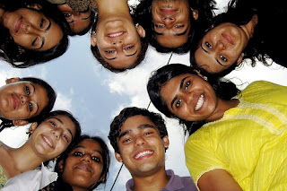
JOIN US!
LET’S BE TOGETHER IN THIS
EVER EVOLVING WORLD

Slide 27
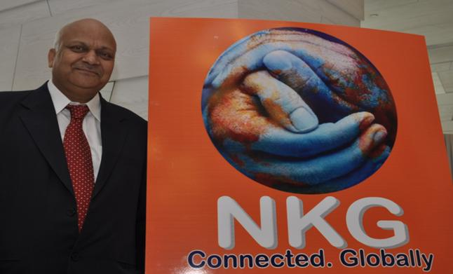
Thanks get Connected
nkgoyals@yahoo.co.in
Ph No. - +91 98111 29879
http://in.linkedin.com/in/nkgoyals,
http://www.facebook.com/nkgoyalcmai

